Slide 1
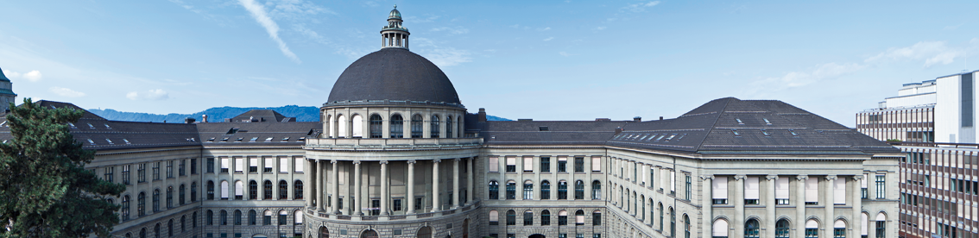
Proposal Presentation
Deep Relative Pose Estimation for Stereo Camera

Slide 2
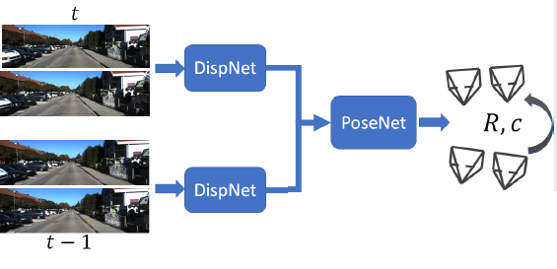

Goal
Designing an end-to-end neural network for depth and relative pose estimation between two frames of a stereo camera

Slide 3
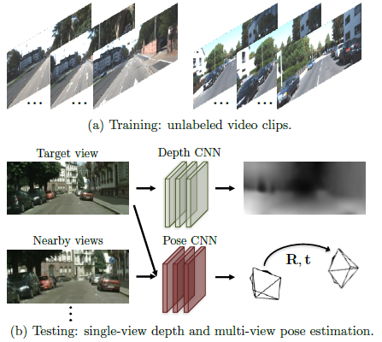
Existing work
Depth and relative pose estimation for a monocular camera
Tinghui Zhou, Matthew Brown, Noah Snavely, and David G. Lowe. Unsupervised learning of depth and ego-motion from video.

Slide 4
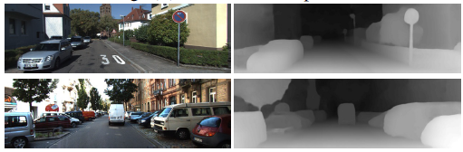
Existing work
DispNet, an algorith estimating depth from images of a stereo camera
N.Mayer, E.Ilg, P.Häusser, P.Fischer, D.Cremers, A.Dosovitskiy, and T.Brox. A large dataset to train convolutional networks for disparity,
optical flow, and scene flow estimation.

Slide 6
